Slide 1
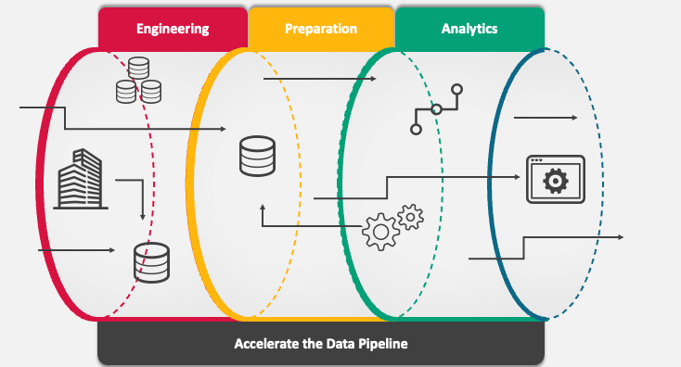
AI Pipeline for Image Segmentation and Object Analysis
Hritika Vaishnav
20/08/2024

Slide 2
Objective & Overview
Objective:
Develop an AI pipeline for image segmentation, object identification, and data extraction.
Output includes summarized and mapped data with a visual interface for user interaction.
Overview:
The pipeline involves several key steps, from image segmentation to data extraction and visualization.
Implemented using google colab with python, tensorflow, pytorch, opencv, and streamlit.

Slide 3
Methodology
1. Image segmentation
Concept: partition an image into segments representing objects.
Implementation: used mask r-cnn (pre-trained on coco dataset) for instance segmentation.
Visualization: display original image, segmentation mask, and bounding boxes using matplotlib.
2. Object extraction & storage
Concept: extract and save segmented objects.
Implementation: each object is saved with a unique id, and metadata is stored for reference.
3. Object identification
Concept: recognize each segmented object.
Implementation: used yolo (faster r-cnn) for object identification, results stored in metadata.

Slide 4
Data Extraction, Summarization & Mapping
4. Text/data extraction
Concept: extract text from objects using OCR.
Implementation: applied easyocr to extract text from objects like documents or signs.
5. Data mapping & summarization
Concept: summarize object attributes and extracted data.
Implementation: data summarized in a csv, providing a quick overview of all objects and their attributes.
6. Output generation
Concept: generate final outputs, highlighting segmented objects with their labels.
Implementation: visual outputs are saved, and a streamlit ui is built for easy interaction.

Slide 5
Results & Visualization
Final output:
Segmentation and identification: the pipeline successfully segmented and identified objects in images.
Data extraction: extracted text data accurately from objects containing text.
Summarization: created a comprehensive summary csv for all segmented objects.
Visualization:
Streamlit UI: users can upload images, run the pipeline, and view results interactively.
Output image: display segmented objects with bounding boxes and labels.

Slide 6
Thank you

